Slide 1




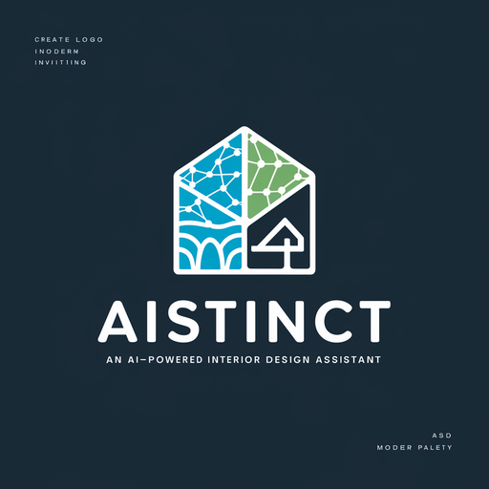

AIstinct: an AI Interior Decoration Design Assistant
Member：尹博，蔡子皓，夏嘉男，陈其越，何誉
Date：2024/6/19

Slide 2



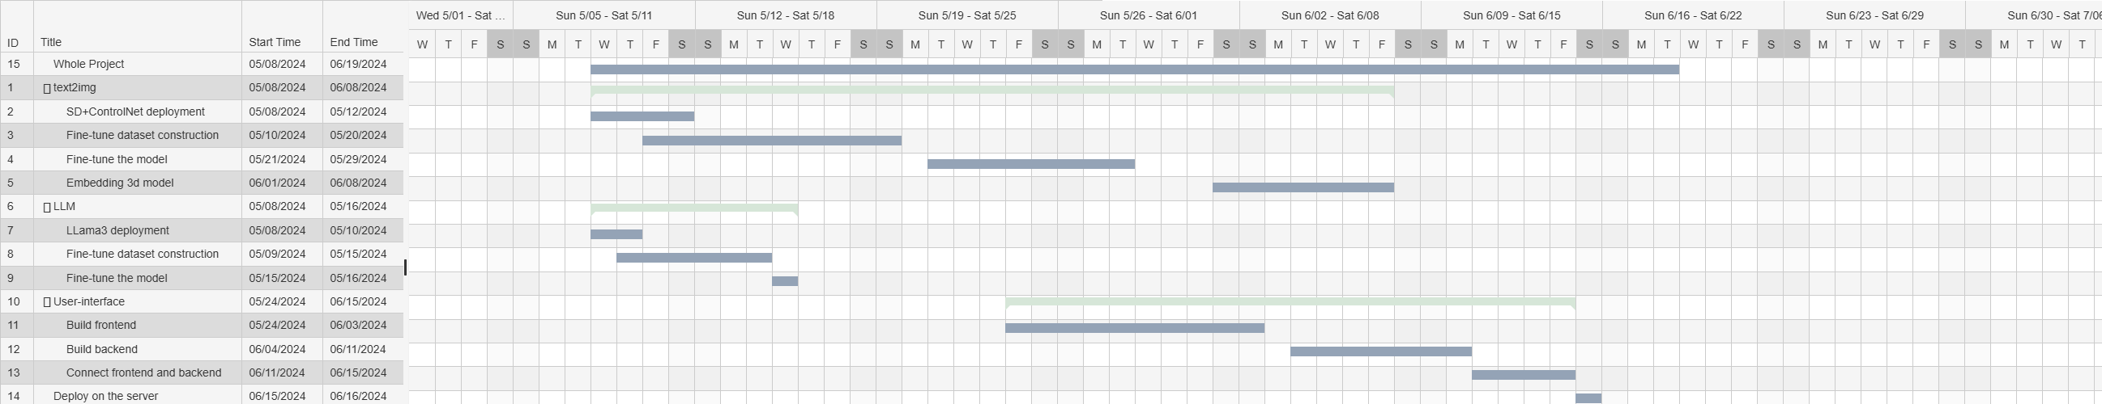

Project Schedule and Completion Status

Slide 3
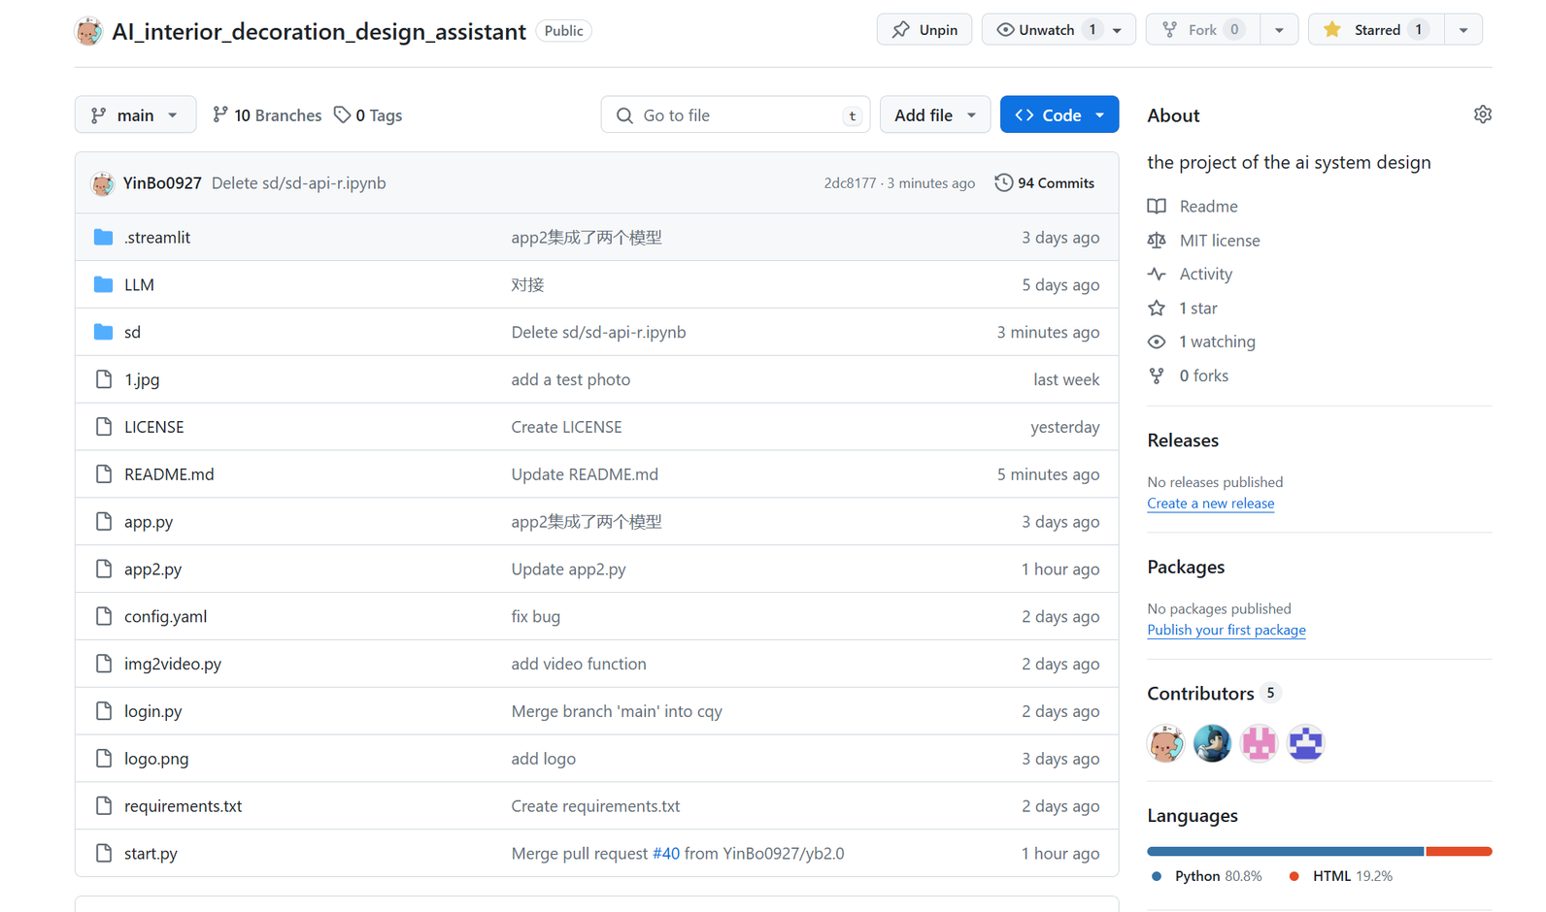
We set up projects on github and collaborate through git, which is very convenient.

Slide 4


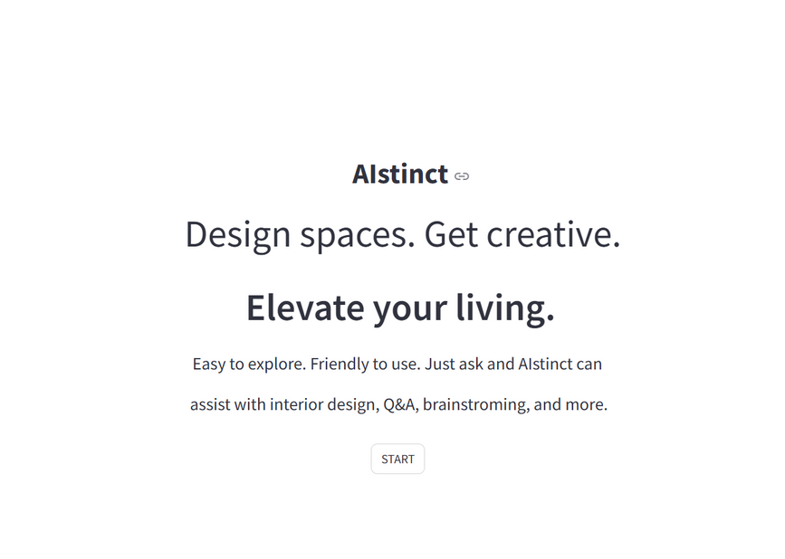
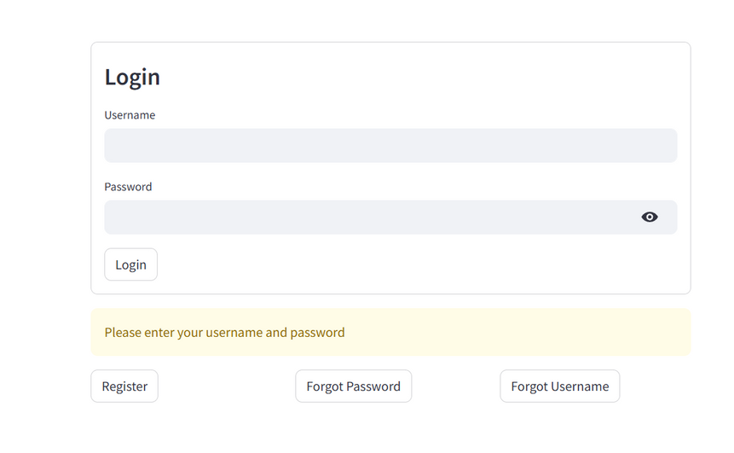

Project Completion Status
Start and log in part
The overall minimalist style adopts black and white. The concise welcome interface and message introduce the concept of our product
The login interface includes functions such as user registration, password retrieval, and username retrieval.

Slide 5
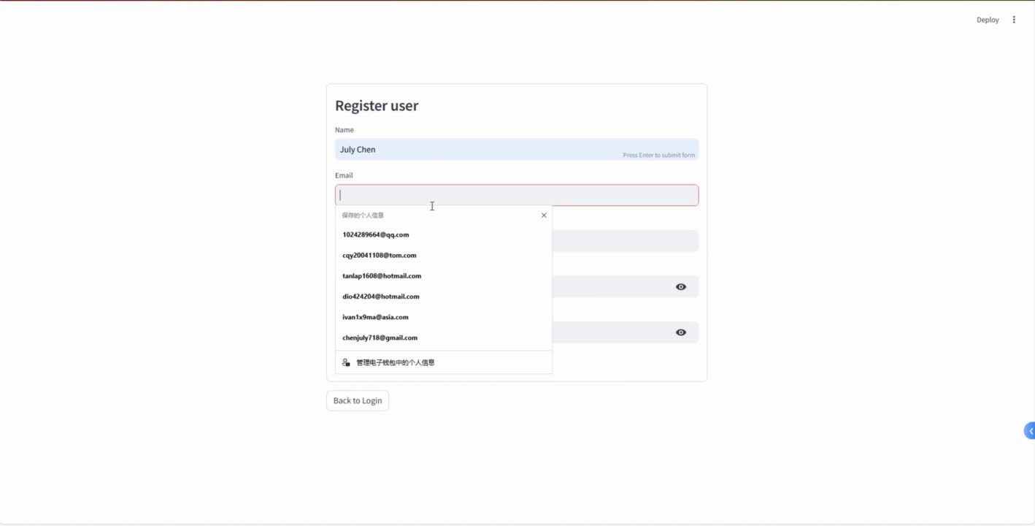

Slide 6
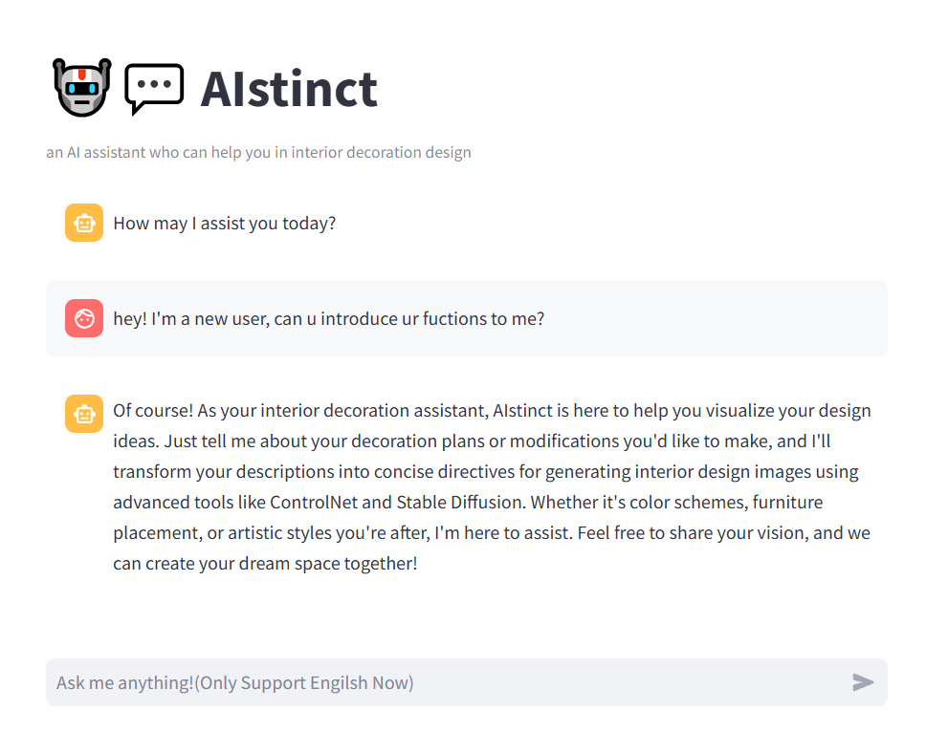
Project Completion Status
Chat part
In the chat interface, you can chat with AIstinct and ask it any questions. This is one of the themes of our project, Q&A. Not just daily conversations, you can even ask it to provide you with a piece of code! Also our interface supports adjusting the background mode, and users can adjust it to "Light" or "Dark" by themselves

Slide 7
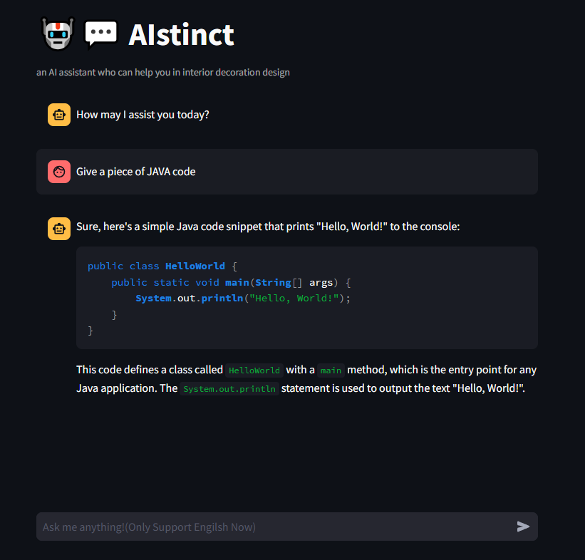
Project Completion Status
Chat part
In the chat interface, you can chat with AIstinct and ask it any questions. This is one of the themes of our project, Q&A. Not just daily conversations, you can even ask it to provide you with a piece of code! Also our interface supports adjusting the background mode, and users can adjust it to "Light" or "Dark" by themselves

Slide 8
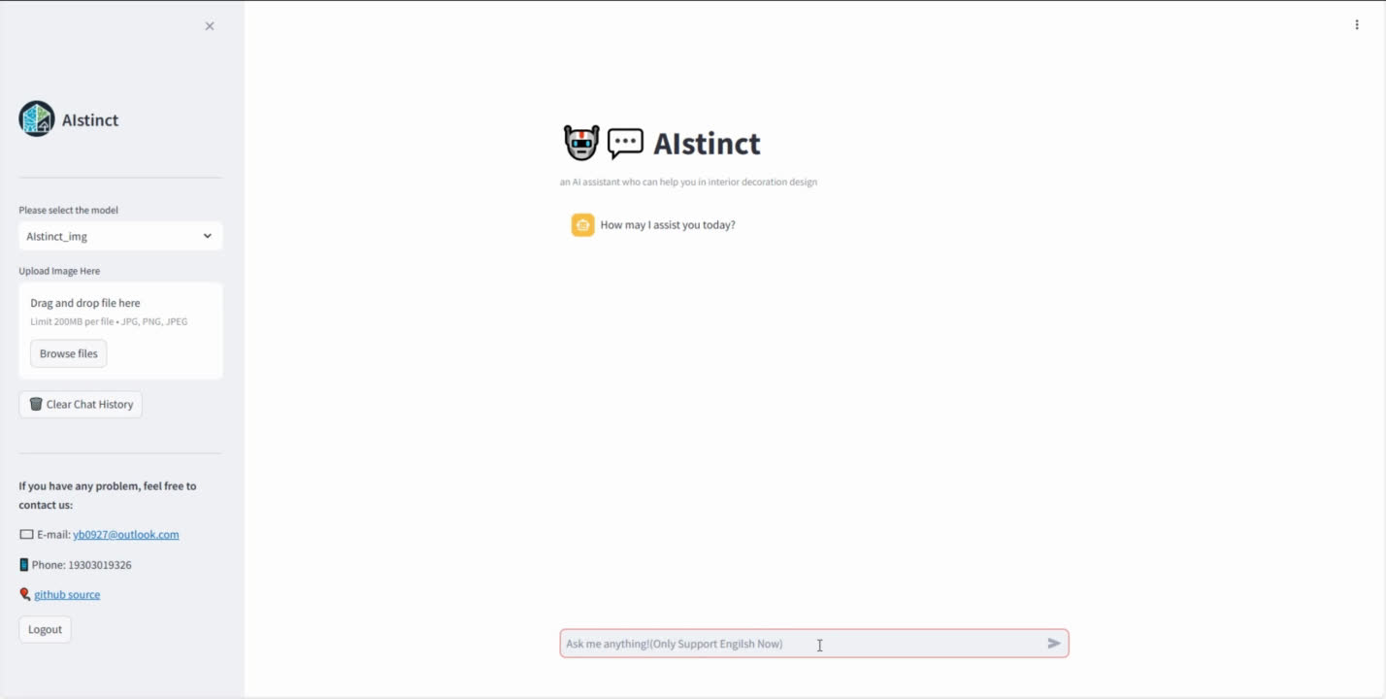

Slide 9
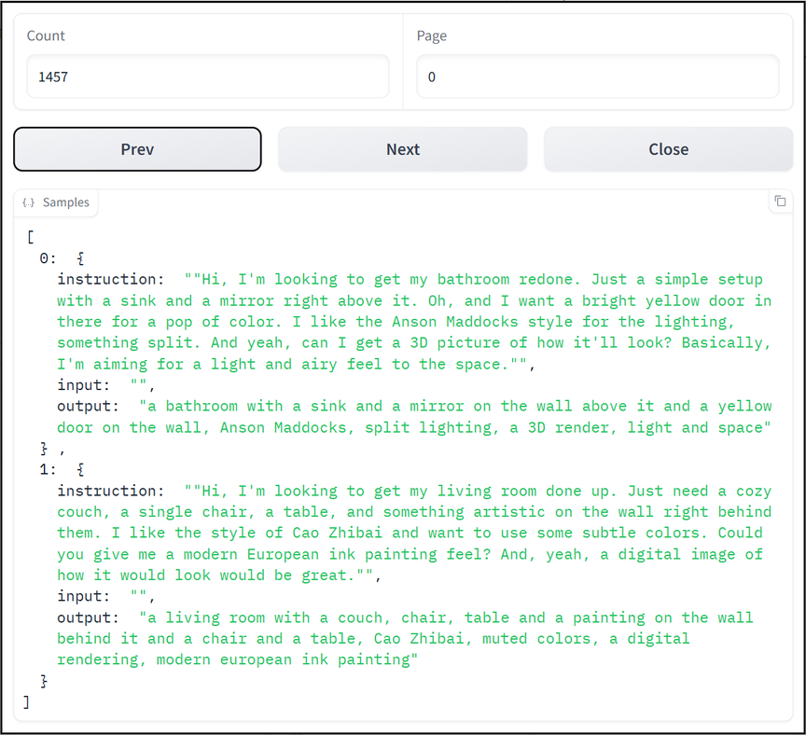
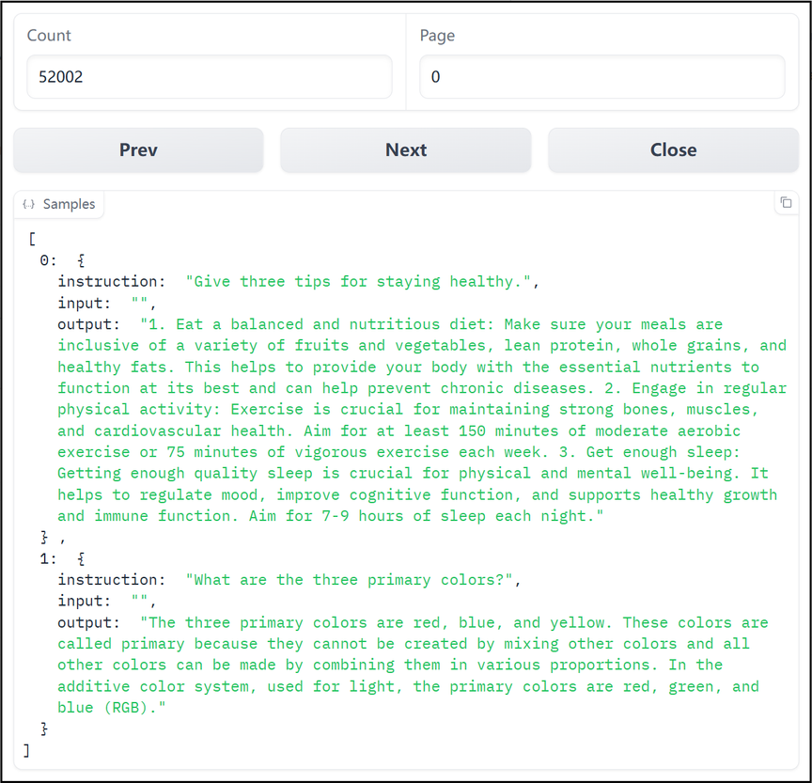
LLM Fine-tuned Dataset Refinement
User Needs Understanding
Issue Identified: Original dataset tuning hinders normal model-user interaction.
Solution Applied: Daily communication dataset generated via GPT3.5 API.
Objective: Tailor LLM model to be more user-friendly and intimate.

Slide 10




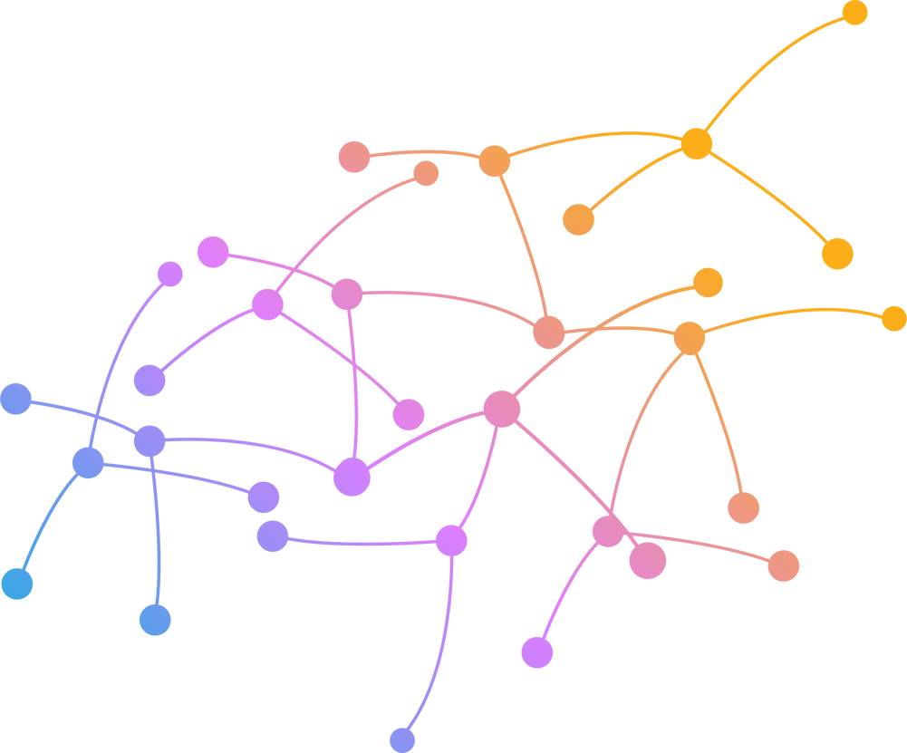
Implementation of User Interaction
User Needs Understanding
Your name is AIstinct who is an assistant to help interior decoration design, if the user mentions a decoration request or some modifications of previous decoration requests in the current user_input, you need to simplify and summarize it. If the user do not mention a decoration request in current user_input and messages, chat with the user in ordinary ways
Prompt
Output
LLama3
LoRA
LoRA

Slide 11
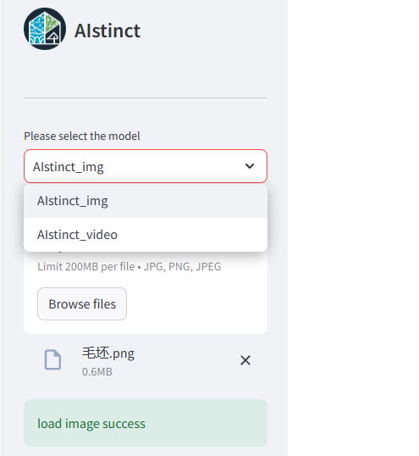
Project Completion Status
Interior design
with users’ image
After the user uploads and uploads pictures of the unfinished house and describes their decoration needs, AIstinct will analyze them and generate a picture that meets the user's needs. If the user chooses to generate a video, Aistinct will generate a 3D video of a room that meets the user's needs

Slide 12
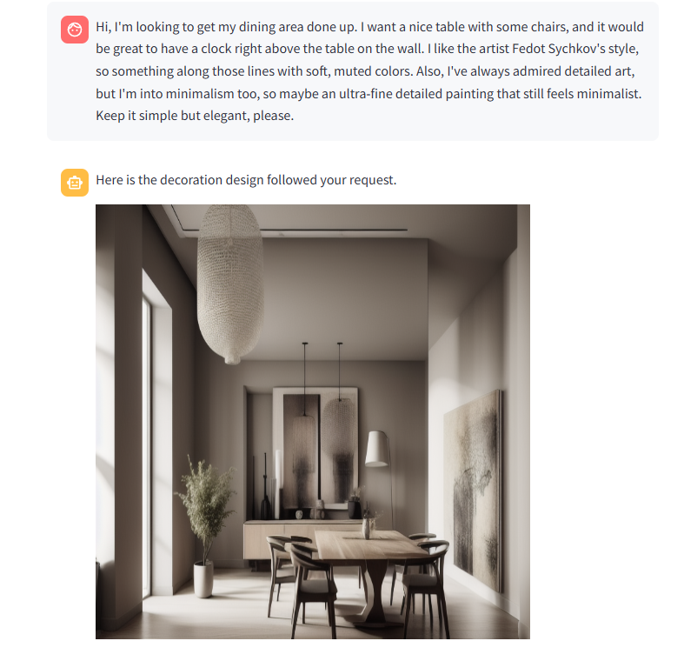
Project Completion Status
Interior design
with users’ image
After the user uploads and uploads pictures of the unfinished house and describes their decoration needs, AIstinct will analyze them and generate a picture that meets the user's needs. If the user chooses to generate a video, Aistinct will generate a 3D video of a room that meets the user's needs

Slide 13
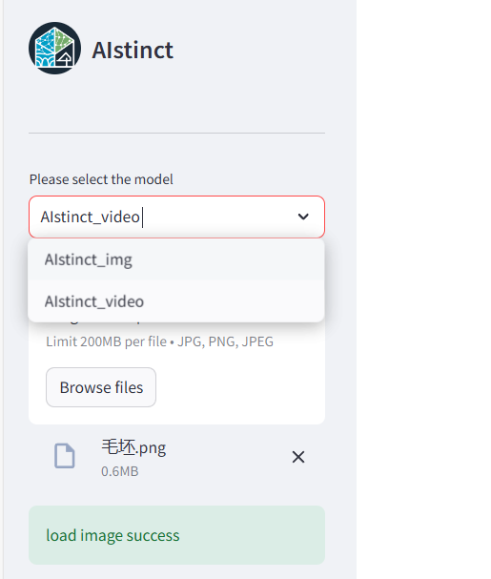
Project Completion Status
Interior design
with users’ image
After the user uploads and uploads pictures of the unfinished house and describes their decoration needs, AIstinct will analyze them and generate a picture that meets the user's needs. If the user chooses to generate a video, Aistinct will generate a 3D video of a room that meets the user's needs

Slide 14
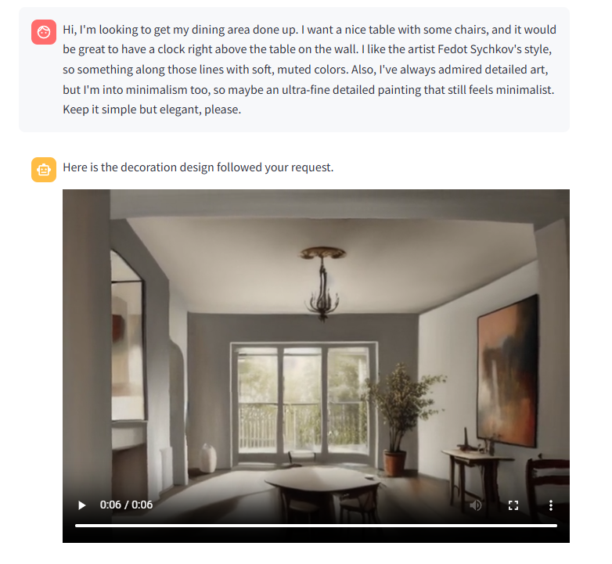
Project Completion Status
Interior design
with users’ image
After the user uploads and uploads pictures of the unfinished house and describes their decoration needs, AIstinct will analyze them and generate a picture that meets the user's needs. If the user chooses to generate a video, Aistinct will generate a 3D video of a room that meets the user's needs

Slide 15
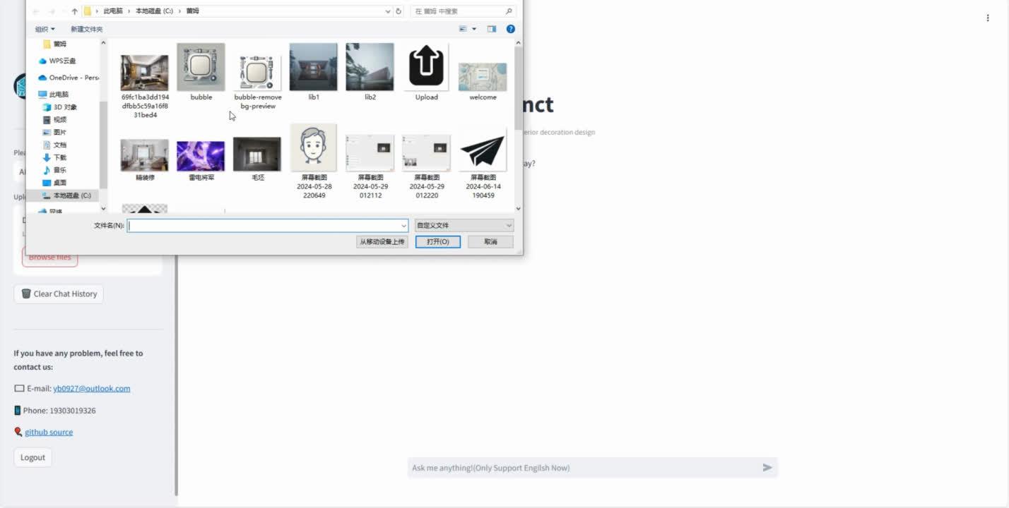

Slide 16
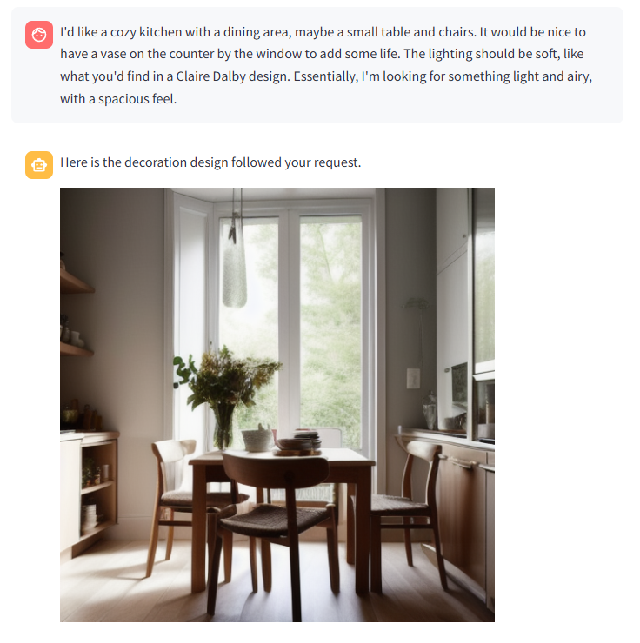
Project Completion Status
Interior design
without users’ image
If the user does not have a rough house image and wants to know the result of a certain type of room after decoration according to their imagination, the user can directly request AIstingct, and AIstingct will generate the decorated image they want. Of course! Users can also choose to generate videos for better viewing

Slide 17
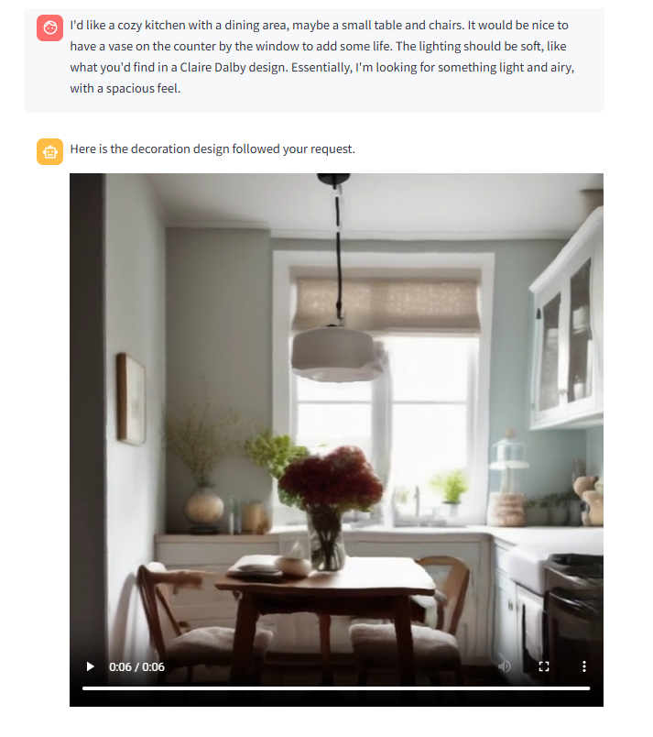
Project Completion Status
Interior design
without users’ image
If the user does not have a rough house image and wants to know the result of a certain type of room after decoration according to their imagination, the user can directly request AIstingct, and AIstingct will generate the decorated image they want. Of course! Users can also choose to generate videos for better viewing

Slide 18
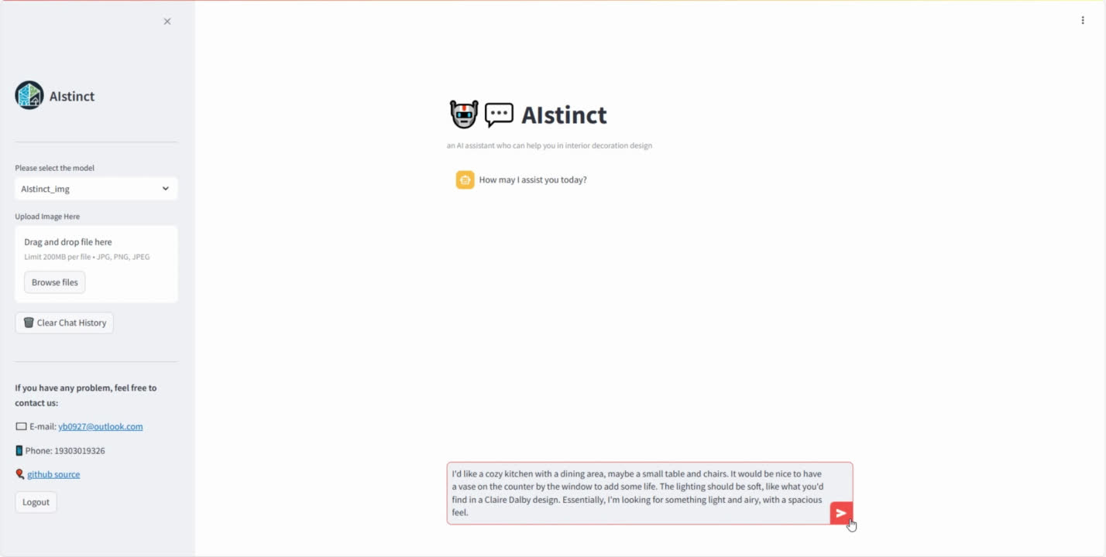

Slide 19
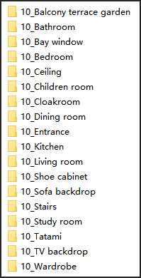
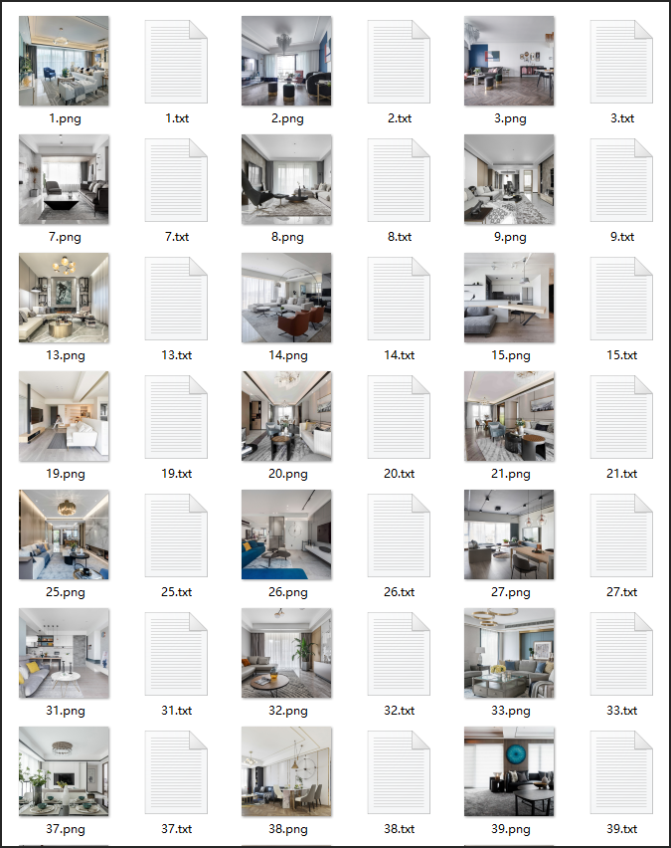
SD Fine-tuned Dataset
1. Construction Method and Source:
- Sourced from several mainstream websites
dedicated to professional interior design.
- By web scraping and manual collection.
2. Dataset Scale:
- over 10,000 high-quality images
3. Labeling Method:
- Using the BLIP model for reverse inference
and employing manual screening.

Slide 20
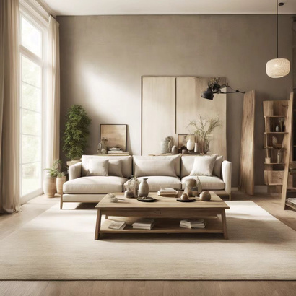
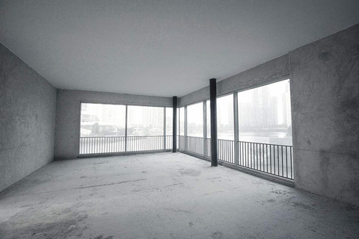
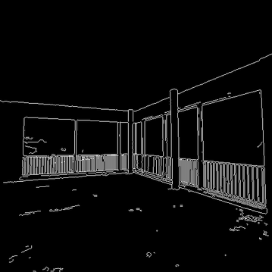
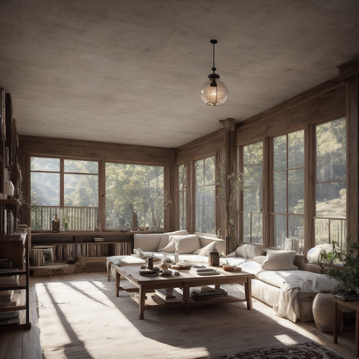


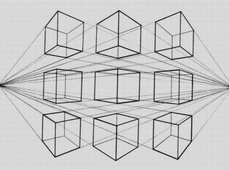
Model Constracting
Interior design
diffusion model
LLM
Your house
controlnet
3D Video
LoRA

Slide 21
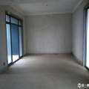
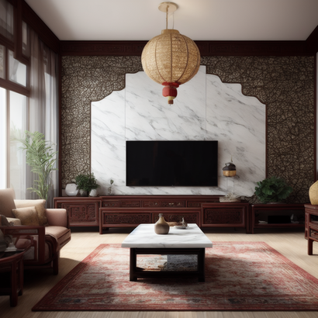
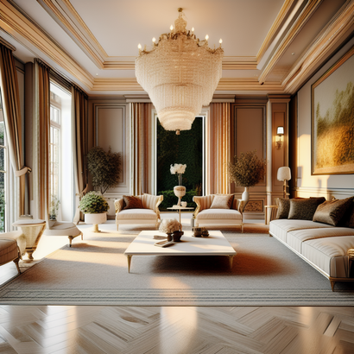
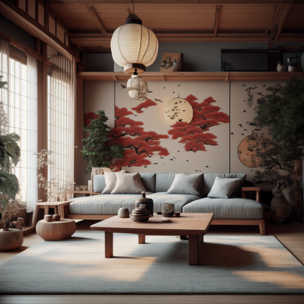
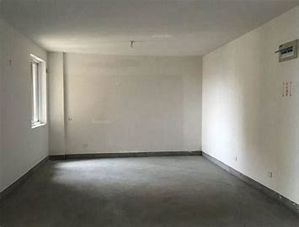
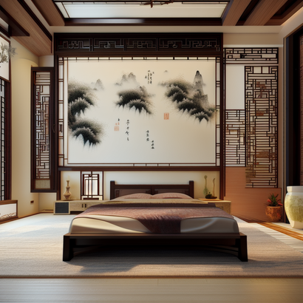
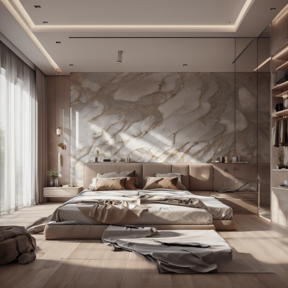
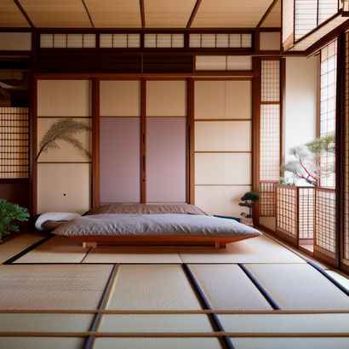
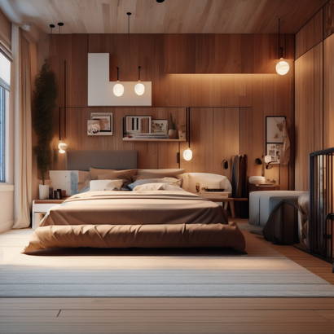
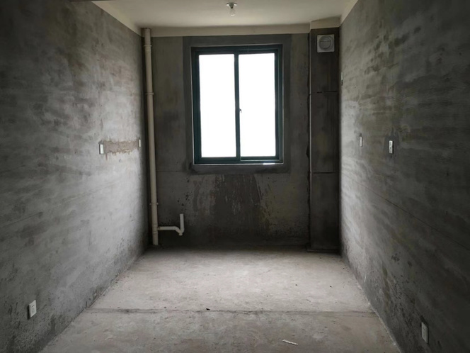
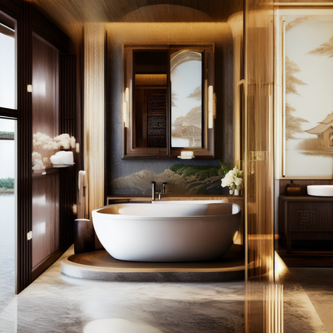
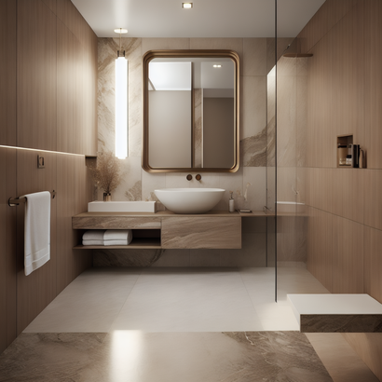
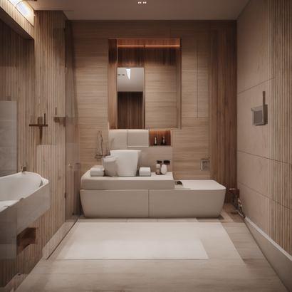
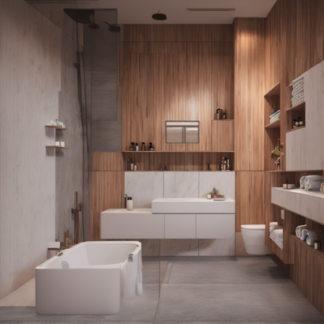
Effects Display -- Still Pictures
 | Base picture | Chinese style | European style | Japanese style | American style
Living room
Bedroom
Bathroom

Slide 22
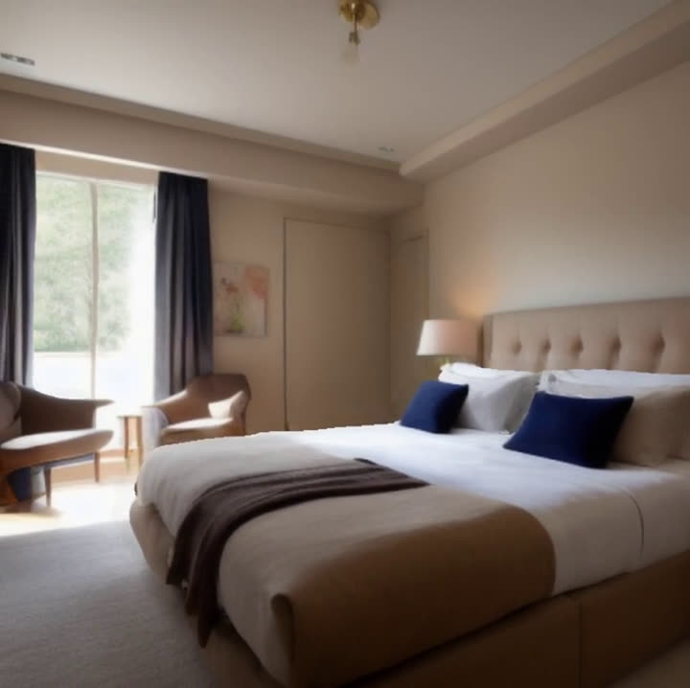
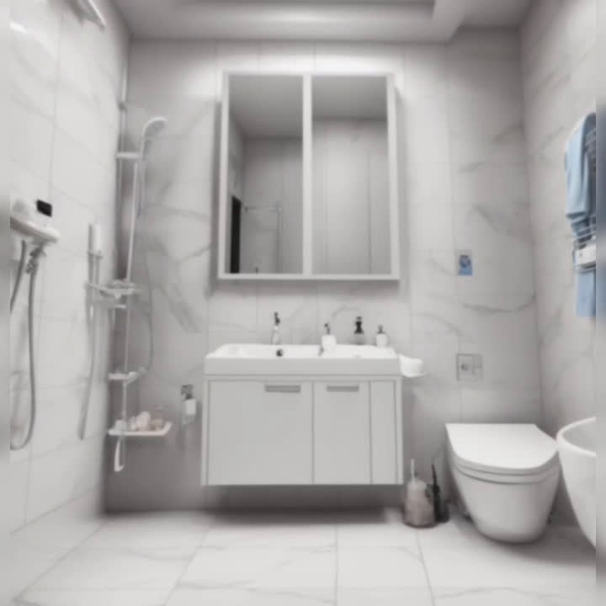
Effects Display -- 3D Pictures
We find a method(3d-photo-impainting) to create 3D photos using a Layered Depth Image with explicit pixel connectivity. It use a deep-learning-based model that fills in occluded regions with color and depth information and allows the efficient rendering of 3D photos with motion parallax using standard graphics engines.

Slide 23
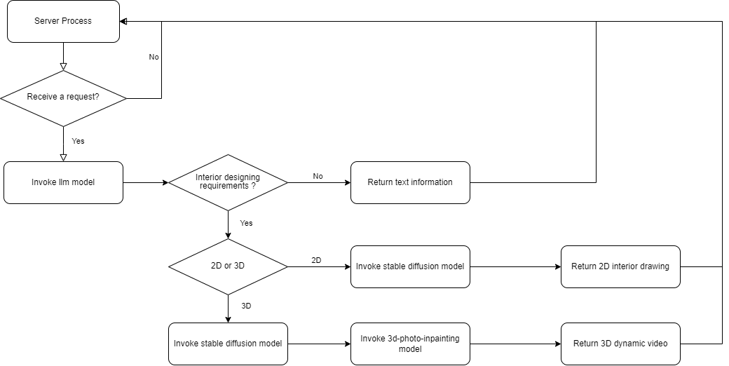
Flowchart of Service Logic

Slide 24


Evaluation of the Generative Image Quality
In the evaluation, we choose two kinds of rooms with bedroom and living room respectively. We tested the scores of a hundred pictures and averaged them. In addition, we also crawled 100 pictures of the same type of room decoration from the Internet and tested them. The scores were acquired by GIQA (ECCV2020).
Room Type | Generated Image | Ordinary Image
Living room | -337.62 | -341.24
Bedroom | -297.73 | -301.54

Slide 25
Evaluation of the Decoration Quality
Due to the low efficiency of the survey method of sending questionnaires, we adopted a large model to score our decoration pictures by Qwen-vl. We rated the design on four aspects: aesthetics, detail, spatial layout, and practicality and feasibility. Out of 10 points, the rating is shown in the table below:
Room Type | Aesthetics | Detail | Spatial Layout | Practicality and Feasibility
Living room | 9.4 | 8.2 | 7.9 | 8.1
Bedroom | 9.3 | 7.8 | 8.0 | 7.5

Slide 26


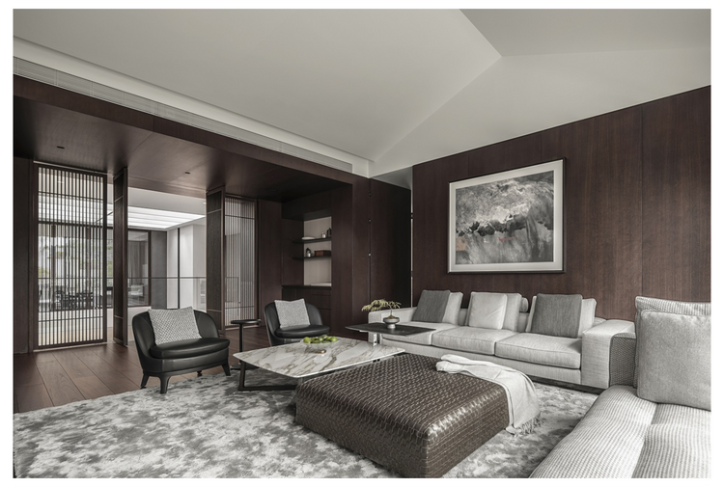
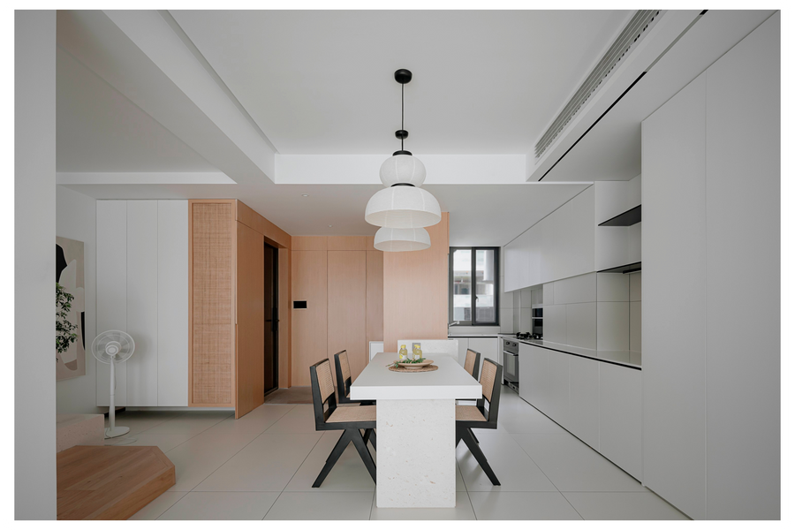

Project Innovation Point (Original Innovation)
We have collected a large number of interior images from the Internet through crawlers and manual collection, and ensured that our image data has excellent clarity, content relevance, and design aesthetics through manual screening and classification. A high-quality dataset will lay a solid foundation for subsequent model fine-tuning and improve the quality of our product-generated images.

Slide 27
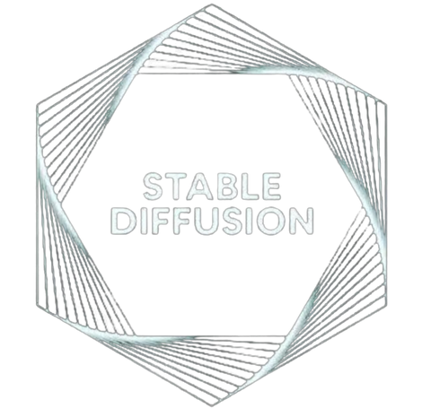
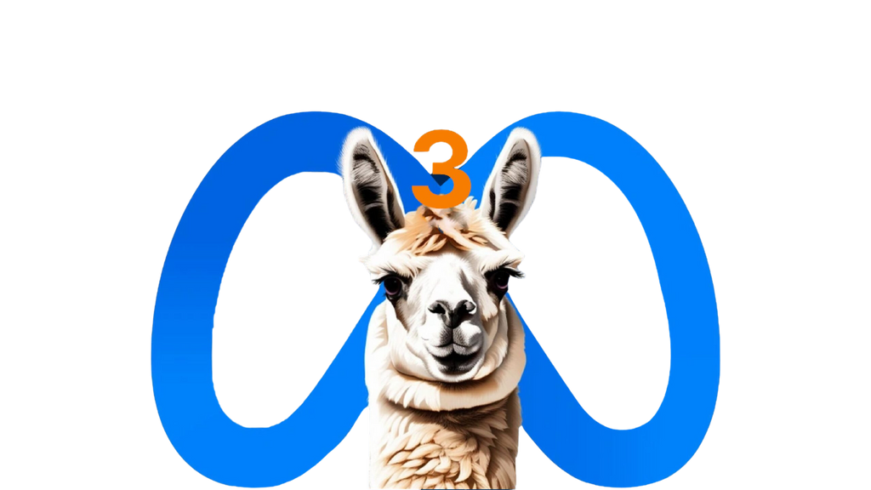
Project Innovation Point (Integrated Innovation)
Our project combines fine-tuned large language model LLama3 and generative model Stable Diffusion. By using LLama3 to understand user needs and convert them into corresponding prompts, it addresses the problem of poor image quality caused by unclear descriptions when users directly use generative models.

Slide 28
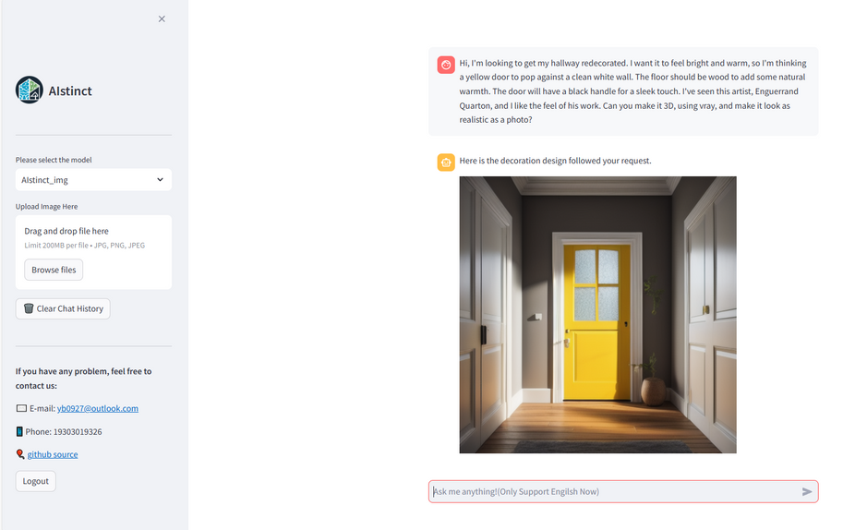
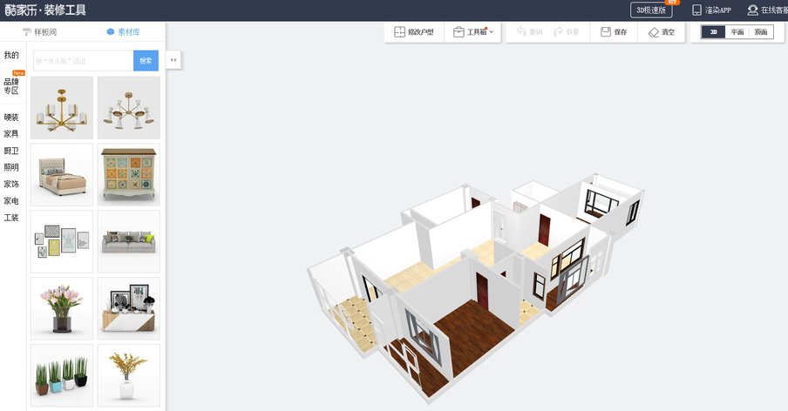
Project Innovation Point (Application Innovation)
Our project combines language models and image generation models, providing highly personalized design suggestions based on the user's personal style, preferences, and needs through a user-friendly interface. This personalization is not only based on user verbal descriptions, but also allows for deeper analysis and understanding through uploaded photos and images, providing design solutions that better meet user expectations.

Slide 29
Market Prospect Analysis
Opportunity
Currently, the global interior design market is experiencing significant growth. In 2021, the market size was $180.73 billion and is expected to reach $401.157 billion by 2031, with an average annual growth rate (CAGR) of 8.3%. This shows the strong growth potential of the industry.
Tendency
With the rapid development of artificial intelligence (AI) technology, the application of AI in interior design has become more and more extensive. Technologies such as computer-aided design (CAD) and 3D printing have greatly improved design efficiency and accuracy. AIstinct is able to provide personalized design recommendations that meet consumers' demands for efficient and intelligent design.

Slide 30
Target Market Analysis
Customer group
Individual users: families and homeowners looking to enhance their quality of life through professional design.
Professional users: including interior designers and design companies seeking to improve design efficiency and customer satisfaction.
Tendency
Individual users: Pursue personalized and simple design experience.
Professional users: Focus on efficient and accurate design tools to improve work efficiency.

Slide 31

Usage on Different Parts
AutoDL Server
Cost ￥332
Baidu Netdisk VIP
Cost ￥98
Alibaba Cloud Server
Cost ￥20
Total expenses: ￥450

Slide 32

Division of Work --Yin Bo
He completes the deployment and fine-tuning of LLama3 on the server.
He investigated the use of images and decoration evaluation methods to evaluate project results.
He implemented the user login interface.
He connected the front and back ends and deploy the project on Alibaba Cloud servers.

Slide 33

Division of Work --Cai Zihao
He implemented the construction of Stable Diffusion Lora fine-tuning datasets.
He implemented the deployment of Stable Diffusion and ControlNet on the server.
He implements API development and encapsulation of deployed models.

Slide 34

Division of Work --Xia Jianan
He implemented Stable Diffusion Lora fine-tuning and evaluated the generation result.
He was responsible for investigating 3d scene construction algorithms.
He deployed a 3d-photo-inpainting model to move from 2d decoration drawings to 3d video.

Slide 35

Division of Work --He Yu
He implemented the construction of the dataset for fine-tuning the LLama3.
He implemented the logic of multiple rounds of LLama3 dialogue and encapsulation.
He uses evaluation algorithms and multimodal large models to evaluate the images and rationality generated by the decoration.

Slide 36

Division of Work --Chen Qiyue
He implemented the design of web frontend and user interface.
He implements the interface logic between the user's back end and the model API.
He tested the entire project to make sure there were no bugs.
As a product manager, he designed the Logo and positioned our project

Slide 37
AIstinct
Design spaces. Get creative.
Elevate your living.

Slide 38



Thanks!

